Slide 1

IOT Application

Slide 2
Sensors time series data
Sensors sense the environment data at every time instant.
Save the data on a computer by establishing the serial communication with the Arduino.
Process the recorded data (Correlation, Granger Causal, Fuzzy logic)
Send the information based to the Arduino and display the information through LED as an output.
Notes:
You can use LCD in future.

Slide 3
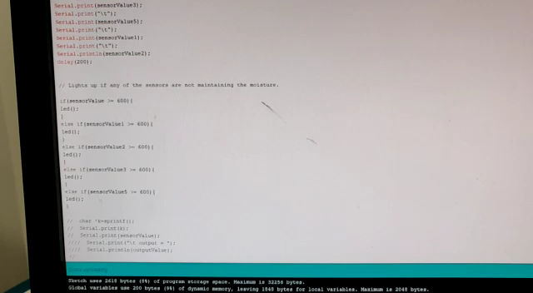
Experiment 1
Processing can be performed with in the Arduino board.
Arduino code is required.

Slide 4
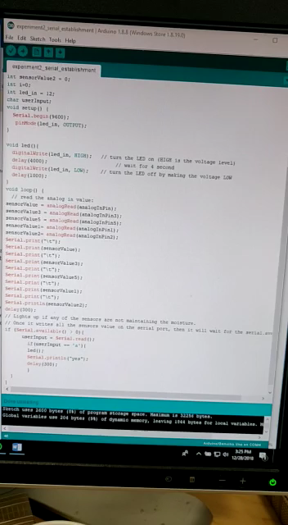
Experiment 2
Processing can be performed in computer.
Arduino as well as pyserial communication code is required.
Care should be taken for properly establishing the communication.
Sensing_Correlation_Fuzzy.ipynb
Notes:
Clear documentation is available.

Slide 5
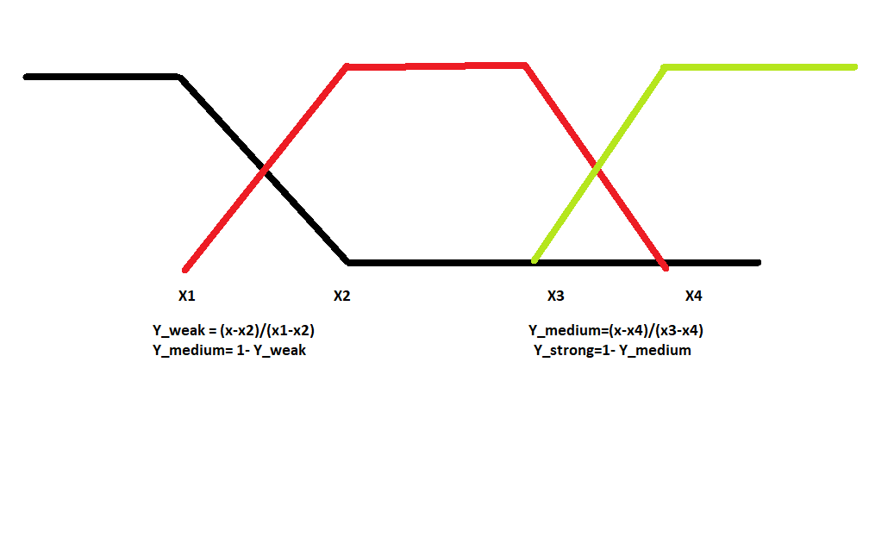
Fuzzy logic
In general as the boundaries between the hot and medium as well as the medium and hot overlap, it’s always better to represent them with the possibility scenario.
Hard encoded logic is implemented.

Slide 6
Sensor individuality correlation
Correlation coefficients for different sensors are implemented.
Since we have time series analysis data for each sensor, we can calculate the correlation between the sensors data.
Application: How different sensors in a similar environment are correlated?
Pearson correlation
Spearman correlation
Kendall’s Tau correlation
Notes:
Pearson correlation
Spearman correlation is good if the data has outliers.
The Kendall’s Tau correlation is a non-parametric test that does not make any assumptions about the distribution of the data. The only assumption is:
There should be a monotonic relationship between the variables being tested

Slide 7
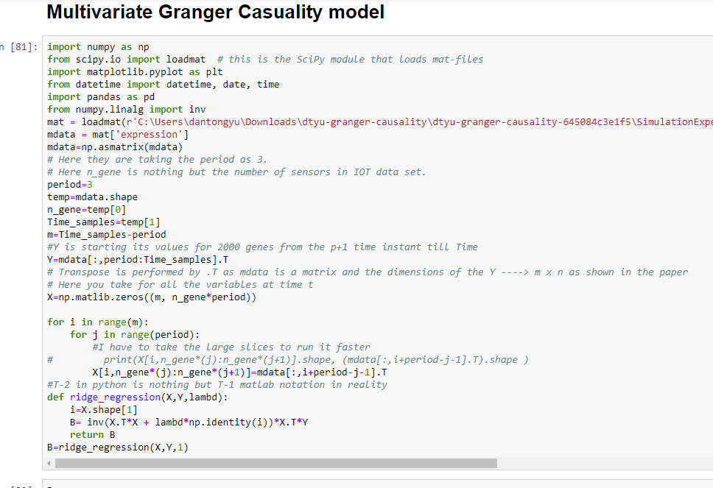
Granger Casuality
Please go through the paper for more information .
We have synthetic data set.
Time steps in this case is only 20.
Taken the data directly from the paper run file.
Sensor_Granger_Causal_Coefficients.ipynb
Notes:
This is some what similar to Auto regression .

Slide 8
Granger casuality on our sensors data set
We have collected the data for our sensors for more than 1700 time steps.
Ran the same steps as previous data set with and without normalization.
Granger_Causal_Coefficients_Yeast_data.ipynb
Notes:
Additional things
Weather data set correlation on the external data set.

